Slide 1

Chapter 20 STL Algorithms

Slide 2
Objectives
To know how to use various types of iterators with the STL algorithms (§§20.1-20.20).
To know the four types of STL algorithm (§20.2).
To use the copy algorithm (§20.3).
To use the algorithms fill, fill_n, generate and generate_n (§§20.4-20.5).
To use the algorithms remove, remove_if, remove_copy, and remove_copy_if (§20.6).
To use Boolean functions to specify criteria for STL algorithms (§20.6).
To use the algorithms replace, replace_if, replace_copy, and replace_copy_if, find, find_if, find_end, and find_first_of (§§20.7-20.8).
To use the algorithms search, search_n, sort, binary_search, adjacent_find, merge, and inplace_merge (§§20.9-20.11).
To use function objects in STL algorithms (§20.10).
To use the algorithms reverse, reverse_copy, rotate, rotate_copy, swap, iter_swap, and swap_range (§§20.12-20.14).
To use the algorithms count, count_if, max_element, min_element, random_shuffle, for_each, and transform (§§20.15-20.18).
To use set algorithms includes, set_union, set_difference, set_intersection, set_symmetric_difference (§20.19).
To use numeric algorithms accumulate, adjacent_sort, inner_product, and partial_sum (§20.20).

Slide 3
function and algorithm
The terms operations, algorithms, and functions are interchangeable. Functions are operations and functions are implemented using algorithms.

Slide 4
iterators and pointers
Iterators are a generalization of pointers. Pointers themselves are iterators. So the array pointers can be treated as iterators. Iterators are often used with containers, but some iterators such as istream_iterator and ostream_iterator are not associated with containers at all.

Slide 5
Types of Algorithms
The STL provides approximately 80 algorithms. The algorithms can be classified into four groups:
Nonmodifying Algorithms
Modifying Algorithms
Numeric Algorithms
Heap Algorithms

Slide 6

copy
template <typename InputIterator, typename OutputIterator>
copy(InputIterator beg, InputIterator end,
OutputIterator targetPostition)
CopyDemo

Slide 7
fill and fill_n
template <typename ForwardIterator, typename T>
void fill(ForwardIterator beg, ForwardIterator end, const T &value)
template <typename ForwardIterator, typename size, typename T>
void fill_n(ForwardIterator beg, size n, const T &value)
FillDemo

Slide 8
generate and generate_n
template <typename ForwardIterator, typename function>
void generate(ForwardIterator beg, ForwardIterator end, function gen)
template <typename ForwardIterator, typename size, typename function>
void generate_n(ForwardIterator beg, size n, function gen)
GenerateDemo

Slide 9
remove, remove_if
template <typename ForwardIterator, typename T>
ForwardIterator remove(ForwardIterator beg,
ForwardIterator end, const T &value)
template <typename ForwardIterator, typename boolFunction>
ForwardIterator remove_if(ForwardIterator beg,
ForwardIterator end, boolFunction f)
RemoveDemo

Slide 10
remove_copy, and remove_copy_if
template <typename InputIterator, typename OutputIterator, typename T>
OutputIterator remove_copy(InputIterator beg, InputIterator end,
OutputIterator targetPosition, const T &value)
template <typename InputIterator, typename OutputIterator,
typename boolFunction>
OutputIterator remove_copy_if(InputIterator beg, InputIterator end,
OutputIterator targetPosition, boolFunction f)
RemoveCopyDemo

Slide 11
replace, replace_if
template <typename ForwardIterator, typename T>
void replace(ForwardIterator beg, ForwardIterator end,
const T &oldValue, const T &newValue)
template <typename ForwardIterator, typename boolFunction, typename T>
void replace_if(ForwardIterator beg, ForwardIterator end,
boolFunction f, const T &newValue)
ReplaceDemo

Slide 12
replace_copy, and replace_copy_if
template <typename ForwardIterator, typename OutputIterator,
typename T>
ForwardIterator replace_copy(ForwardIterator beg,
ForwardIterator end, OutputIterator targetPosition,
T &oldValue, T &newValue)
template <typename ForwardIterator, typename OutputIterator,
typename boolFunction, typename T>
ForwardIterator replace_copy_if(ForwardIterator beg,
ForwardIterator end, OutputIterator targetPosition,
boolFunction f, const T &newValue)
ReplaceCopyDemo

Slide 13
find, find_if,
template <typename InputIterator, typename T>
InputIterator find(InputIterator beg, InputIterator end, T &value)
template <typename InputIterator, typename boolFunction>
InputIterator find_if(InputIterator beg, InputIterator end,
boolFunction f)
FindDemo

Slide 14
Find_end
template <typename ForwardIterator1, typename ForwardIterator2>
ForwardIterator find_end(ForwardIterator1 beg1, ForwardIterator1 end1,
ForwardIterator2 beg2, ForwardIterator2 end2)
template <typename ForwardIterator1, typename ForwardIterator2,
typename boolFunction>
ForwardIterator find_end(ForwardIterator1 beg1, ForwardIterator1 end1,
ForwardIterator2 beg2, ForwardIterator2 end2, boolFunction f)
FindEndDemo

Slide 15
find_first_of
template <typename ForwardIterator1, typename ForwardIterator2>
ForwardIterator find_first_of(ForwardIterator1 beg1,
ForwardIterator1 end1, ForwardIterator2 beg2,
ForwardIterator2 end2)
template <typename ForwardIterator1, typename ForwardIterator2,
typename boolFunction>
ForwardIterator find_first_of(ForwardIterator1 beg1,
ForwardIterator1 end1, ForwardIterator2 beg2,
ForwardIterator2 end2, boolFunction)
FindFirstOf

Slide 16
search and search_n
template <typename ForwardIterator1, typename ForwardIterator2>
ForwardIterator search(ForwardIterator1 beg1, ForwardIterator1 end1,
ForwardIterator2 beg2, ForwardIterator2 end2)
template <typename ForwardIterator1, typename ForwardIterator2,
typename boolFunction>
ForwardIterator search(ForwardIterator1 beg1, ForwardIterator1 end1,
ForwardIterator2 beg2, ForwardIterator2 end2, boolFunction)
SearchDemo

Slide 17
sort
template <typename RandomAccessIterator>
void sort(RandomAccessIterator beg, RandomAccessIterator end)
template <typename RandomAccessIterator, typename relationalOperator>
void sort(RandomAccessIterator beg, RandomAccessIterator end,
relationalOperator op)
SortDemo

Slide 18
binary_search
template <typename ForwardIterator, typename T>
bool binary_search(ForwardIterator beg,
ForwardIterator end, const T &value)
template <typename ForwardIterator, typename T,
typename strickWeakOrdering>
bool binary_search(ForwardIterator beg,
ForwardIterator end, const T &value, strickWeakOrdering op)

Slide 19
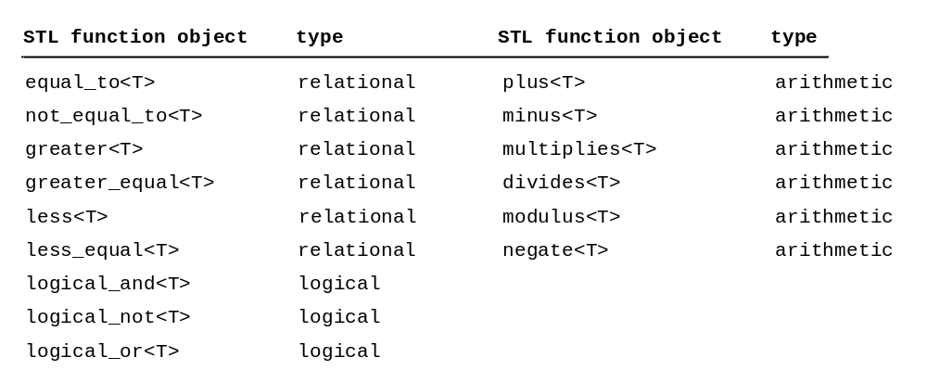
Function Objects

Slide 20
adjacent_find
template <typename ForwardIterator>
ForwardIterator adjacent_find(ForwardIterator beg,
ForwardIterator end)
template <typename ForwardIterator, typename boolFunction>
ForwardIterator adjacent_find(ForwardIterator beg,
ForwardIterator end, boolFunction f)

Slide 21
merge
template <typename bidireationalIterator>
void inplace_merge(BidirectionIterator beg,
BidirectionIterator middle, BidirectionIterator end)
template <typename bidireationalIterator, typename relationalOperator>
void inplace_merge(BidirectionIterator beg,
BidirectionIterator middle, BidirectionIterator end,
relationalOperator)
MergeDemo

Slide 22
reverse and reverse_copy
template <typename bidireationalIterator>
void reverse(BidirectionalIterator beg,
BidirectionalIterator end)
template <typename bidireationalIterator, typename OutputIterator>
OutputIterator reverse_copy(BidirectionalIterator beg,
BidirectionalIterator end, OutputIterator targetPosition)
ReverseDemo

Slide 23
rotate and rotate_copy
template <typename ForwardIterator>
void rotate(ForwardIterator beg, ForwardIterator newBeg,
ForwardIterator end)
template <typename ForwardIterator, typename OutputIterator>
OutputIterator rotate_copy(ForwardIterator beg, ForwardIterator newBeg,
ForwardIterator end, OutputIterator targetPosition)
RotateDemo

Slide 24
swap
template <typename T>
void swap(T &value1, T &value2)
template <typename ForwardIterator1, typename ForwardIterator2>
void iter_swap(ForwardIterator p1, ForwardIterator p2)
template <typename ForwardIterator1, typename ForwardIterator2>
ForwardIterator swap_ranges(
ForwardIterator1 beg1, ForwardIterator1 end1,
ForwardIterator2 beg2)
SwapDemo

Slide 25
count and count_if
template <typename InputIterator, typename T>
int count(InputIterator beg, InputIterator end, const T &value)
template <typename InputIterator, typename boolFunction>
int count_if(InputIterator beg, InputIterator end, boolFunction f)
CountDemo

Slide 26
max_element and min_element
template <typename ForwardIterator>
ForwardIterator max_element(ForwardIterator beg,
ForwardIterator end)
template <typename ForwardIterator>
ForwardIterator min_element(ForwardIterator beg,
ForwardIterator end)
MaxMinDemo

Slide 27
random_shuffle
template <typename RandomAccessIterator>
void random_shuffle(RandomAccessIterator beg,
RandomAccessIterator end)
ShuffleDemo

Slide 28
for_each and transform
template <typename InputIterator, typename function>
void for_each(InputIterator beg, InputIterator end, function f)
template <typename InputIterator, typename OutputIterator,
typename function>
outputIteration transform(InputIterator beg,
InputIterator end, OutputIterator targetPosition, function f)
ForEachDemo

Slide 29
Set Operations
template <typename InputIterator1, typename InputIterator2>
bool includes(InputIterator1 beg1, InputIterator1 end1,
InputIterator2 beg2, InputIterator2 end2)
SetOperationDemo

